Slide 1
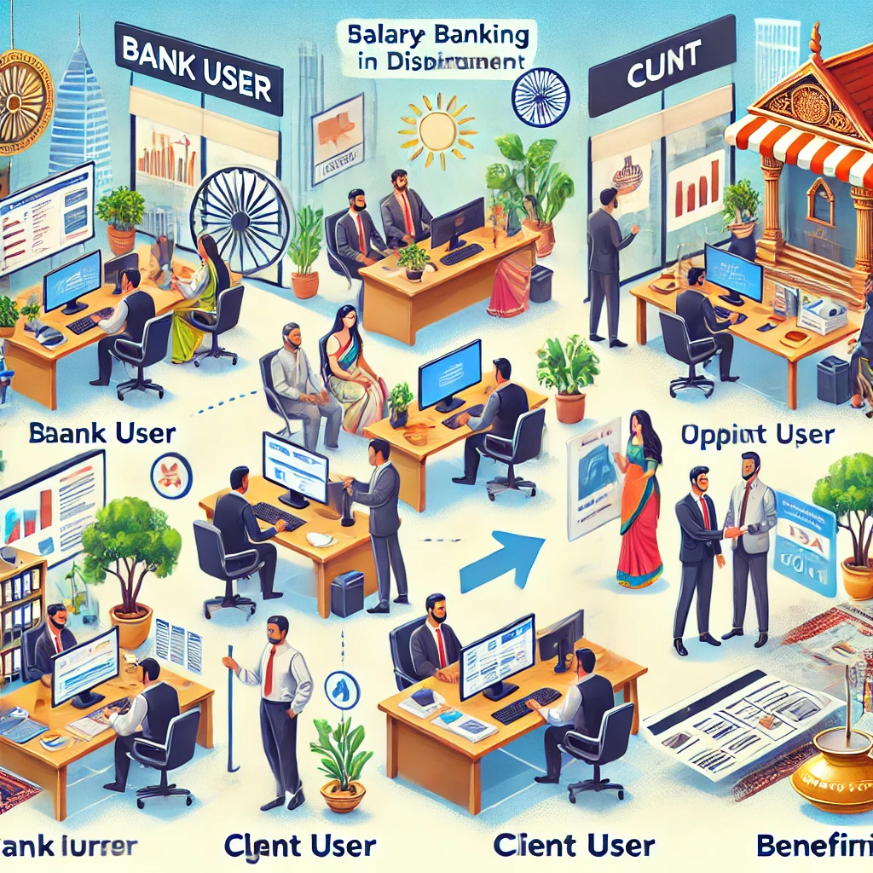

Corporate Banking Payment Application

Slide 2


Your one-stop solution for all your baking needs!
The corporate banking application is designed to streamline banking operations for corporate clients, banks, and super administrators. Key features will include :
- User authentication and authorization
- customer onboarding & verification
- Bank and client management
- payment processing and approval
- salary disbursement to employees
- Processing of transactions
- report generation.

Slide 3
Functional Requirements
Super Admin Management: The system enables the Super Admin to perform CRUD operations on bank records.
Customer Onboarding: The system allows Bank Users to onboard customers, including document uploads, with approval routed through Forcepoint for employee additions.
Client Record Management: The system enables Bank Users to manage and verify client records through CRUD operations.
Payment Request Approval: The system allows Bank Users to approve or reject payment requests from clients.
Transaction Reporting: The system allows Bank Users to generate detailed transaction reports for each customer

Slide 4
Functional Requirements
Beneficiary Management: The system allows Client Users to manage beneficiaries through CRUD operations.
Employee Record Management: The system allows Client Users to manage employee records, including details required for salary disbursement.
Client-to-Client Payments: The system allows Client Users to make payments to other clients.
Salary Disbursement: The system enables Client Users to disburse salaries to employees, either individually or in batch.
Report Generation: The system allows Client Users to generate reports for transactions, payments, and salary disbursements.
Document Upload and Management: The system supports document uploads and management for both Bank and Client Users.

Slide 5

Product Functions
User authentication and authorization
Bank and client management
Customer onboarding and verification
Payment processing and approval
Salary disbursement to employees
Document upload and management
Batch processing of transactions
Report generation

Slide 6
User Categories
Super Admin: Manages banks and generates various reports.
Bank User: Manages clients, verifies customers, approves/rejects payments, uploads documents, and generates reports.
Client User: Manages beneficiaries and employees, processes payments, disburses salaries, and views reports

Slide 7
User roles and responsibilities
Client User Features
Beneficiary Management: Clients can create, read, update, and delete beneficiary records.
Employee Management: Clients can manage employee records necessary for salary disbursement.
Payment Processing: Clients can make payments to other clients.
Salary Disbursement: Clients can disburse salaries to employees, either individually or in bulk.
Report Generation: Clients can generate and view reports related to their transactions, payments, and salary disbursements.
Super Admin Features
Bank Management: Super Admin can create, read, update, and delete bank records.
Report Generation: Super Admin has the ability to generate and view various reports, including system usage and audit logs.
Bank User Features
Customer Onboarding: Bank users can onboard new customers by entering their details and uploading necessary documents.
Client Management: Perform CRUD operations on client records and verify client information.
Payment Approval: Bank users can approve or reject payment requests from clients.
Transaction Reporting: Generate transaction reports for each customer.
Document Management: Upload and manage documents related to clients and transactions.

Slide 8
BANK-RELATED ENDPOINTS
ROLE | ENDPOINT
API PREFIX | /api/v1/bankManagement
Create SuperAdmin | POST /users/createSuperAdmin
Create Bank | POST /banks
Update Bank by ID | PUT /banks/{bank_id}
Delete Bank by ID | DELETE /banks/{bank_id}
Get Bank by ID | GET /banks/{bank_id}
Get All Banks | GET /banks
DOCUMENT-RELATED ENDPOINTS
ROLE | ENDPOINT
API PREFIX | /api/v1/bankManagement
Upload Document | POST /bank/{bank_id}/documents
Get Document by ID | GET /bank/{bank_id}/documents/{document_id}
Get All Document | GET /banks/{bank_id}/documents
Delete Document by ID | DELETE /banks/{bank_id}/documents/{document_id}

Slide 9
CLIENTS Related ENDPOINTS
ROLE | ENDPOINT
API PREFIX | /api/v1/bankManagement
Create Client | POST /banks/{bank_id}/clients
Update Client by ID | PUT /banks/{bank_id}/clients/{client_id}
Delete Client by ID | DELETE /banks/{bank_id}/clients/{client_id}
Get Client by ID | GET /banks/{bank_id}/clients/{client_id}
Get All Clients | GET /banks/{bank_id}/clients
payment related Endpoints
ROLE | ENDPOINT
API PREFIX | /api/v1/bankManagement
Approve Payment Request | GET /banks/{bank_id}/payment_requests/{payment_request_id}/approve
Reject Payment Request | GET /banks/{bank_id}/payment_requests/{payment_request_id}/reject
Get Payment Request | GET /banks/{bank_id}/payment_requests/{id}

Slide 10
Employee-related Endpoints
ROLE | ENDPOINT
API Prefix | /api/v1/bankManagement
Create Employee | POST /clients/{client_id}/employees
Get Employee by ID | GET /clients/{client_id}/employees/{employee_id}
Get All Employees | GET /clients/{client_id}/employees
Update Employee by ID | PUT /clients/{client_id}/employees/{employee_id}
Delete Employee by ID | DELETE /clients/{client_id}/employees/{employee_id}
Reports, salary related Endpoints
ROLE | ENDPOINT
API Prefix | /api/v1/bankManagement
Salary Report | POST /clients/{client_id}/reports/salary_report
Payment Report | POST /clients/{client_id}/reports/payment_report
Disburse Salary | POST /clients/{client_id}/disburse_salary

Slide 11
Beneficiary-related Endpoints
ROLE | ENDPOINT
Create Beneficiary | POST /clients/{client_id}/beneficiaries
Get All Beneficiaries | GET /clients/{client_id}/beneficiaries
Update Beneficiary | PUT /clients/{client_id}/beneficiaries/{beneficiary_id}
Delete Beneficiary | DELETE /clients/{client_id}/beneficiaries/{beneficiary_id}
GET BANK | POST /clients/{client_id}/make_payment
Get All Payment Requests for Client | GET /clients/{client_id}/payments_requests GET /clients/{client_id}/payments
TRANSACTION-RELATED ENDPOINT
ROLE | ENDPOINT
API Prefix | /api/v1/bankManagement
Generate Transaction Report | POST /transactions/{client_id}/reports

Slide 12

THANK YOU
Contributed By :
Sushant Chauhan
Tanmai Kamat
Github Link :
https://github.com/tanmaikamat-forcepoint/Banking-App-Golang

